Slide 1
Ce-202
NAME ROLL NO.
BAISHALI BORAH 210104029
IMNASEN AIER 210104047
VIOLINA KASHYAP 210104116

Slide 2
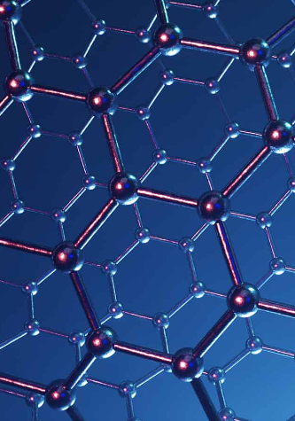
CONTENTS
1
INTRODUCTION
2
DEMONSTRATION
3
APPLICATIONS
Strength-weight ratio and the importance of graphene
Experiment and testing procedure

Slide 3
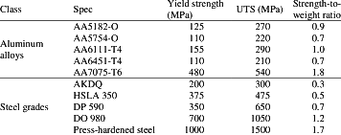
Strength to Weight Ratio
Strength to weight ratio of Steel and Aluminium
All materials have a known strength for a given cross-sectional area and all materials have a density. The
ratio of the two is the strength to weight ratio.
It is defined as the load-carrying capacity of a structural material divided by its weight. For materials in compression, we may use a characteristic compressive stress. Similarly, we may use tensile stress or shear stress depending on application (as obtained from a stress-strain curve) as a measure of strength. For instance, either the yield stress or the ultimate stress could be used, depending upon the particular application.
Graphene material has the world’s best strength-to-weight ratio. It has a sponge-like configuration with a density of just 5 percent yielding a strength 10 times that of steel.

Slide 4
WHY WAS GRAPHENE PREFERRED?
Graphene, in its two-dimensional form, is one of the strongest lightweight materials known.
These 2D sheets are exceptionally thin and they have to be converted into 3D models.
During this conversion, Graphene produces a strong, stable structure whose form resembles that of some corals and microscopic creatures called diatoms.
These shapes have much larger surface area in proportion to their volume and are remarkably strong.
When subjected to heat and pressure during the conversion of 2D structure to 3D form, Graphene forms an unusual geometric shape called gyroid. This geometry has the potential to transfer into many things
This shape is round and full of holes. Due to presence of these tiny pore spaces, Graphene can also find application in some filtration systems, for either chemical or water processing.
On compression and fusion of flakes of Graphene, a new material with sponge-like configuration and only 5% density is formed, which yields strength 10 times that of steel.

Slide 5
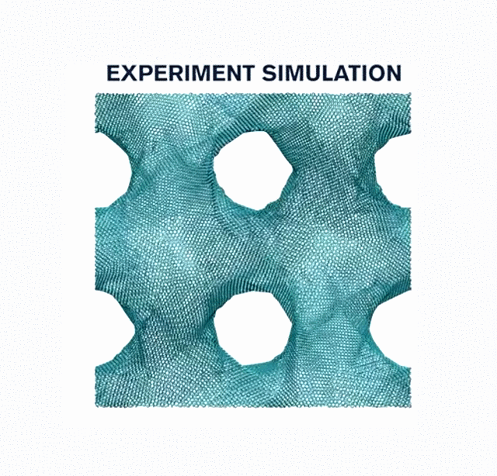
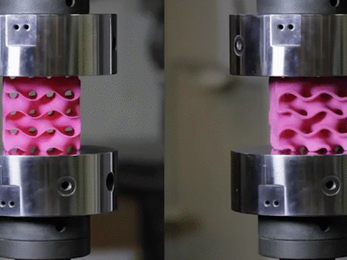
DEMONSTRATION
EXPERIMENT SIMULATION
Initially, Graphene flakes are fused by applying heat and pressure until the flakes formed are stable and are able to reciprocate the 2D strength of graphene.
The new configurations are then made in the lab using a high-resolution, multi-material 3D printer.
They are then mechanically tested for their tensile and compressive properties, and their mechanical response under loading is simulated using theoretical models.
The results from the experiments and simulations matched accordingly.
The final shape is decided after performing multiple tests with different shapes/compositions and the output is based on minor modifications.
MECHANICAL TESTING
*These 3D printed models of the structure are enlarged to thousands of times their natural size, for testing purposes.

Slide 6
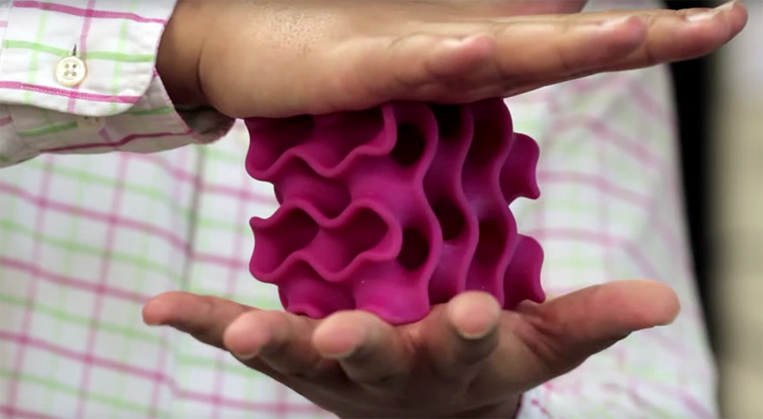

APPLICATION
Graphene, called the miracle material, has taken its place in the global rush industry. Its applications are virtually unlimited and promise to revolutionize many fields: from electronics and computing to construction or even health. Scientists have determined that graphene can assist in detecting cancerous cells in the body and can keep track of a person’s vitals. Graphene can function as an ideal gas detector and it is even used in making bulletproof vests. Batteries based on graphene can recharge incredibly quickly. Graphene is practically impermiable. Just one coating of graphene-based paint will be able to prevent corrosion. Graphene is also used in concrete industries. A new method has been developed to add the material to conventional concrete which combines the lightness and stiffness of graphene into concrete to create concrene.

Slide 7
Thank You

